Slide 1
CS5560 Knowledge Discovery Management Tutorial 1
UMKC

Slide 2
Topics to cover
Git
ZenHub
IntelliJ and PyCharm
SBT and Maven

Slide 3
Git Basic Tasks
1. Create Git remote repository using Git account
2. Clone git repository to your local
3. Use git to add file into local
4. Modify files and use git to commit change
5. Use git to push the commit to remote
6. Use git to pull (sync) content with remote

Slide 4
Git Project Management Tasks
1. Use Git to branch a project
2. Use Git to check different branches
3. Use Git to merge different versions

Slide 5
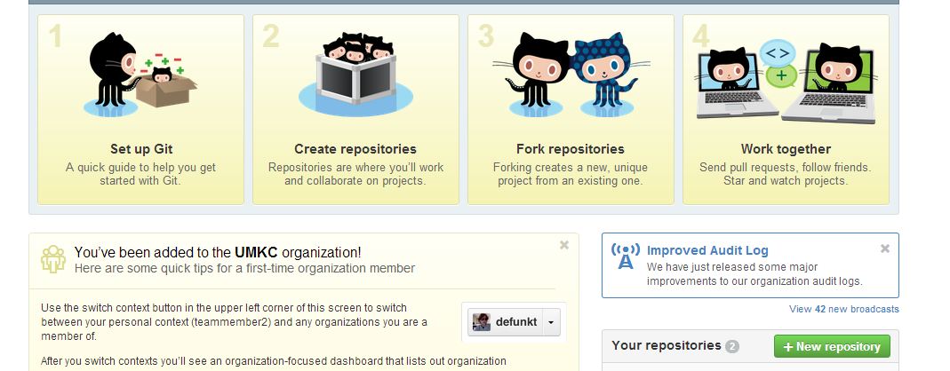
Git 1. Create Repository

Slide 6

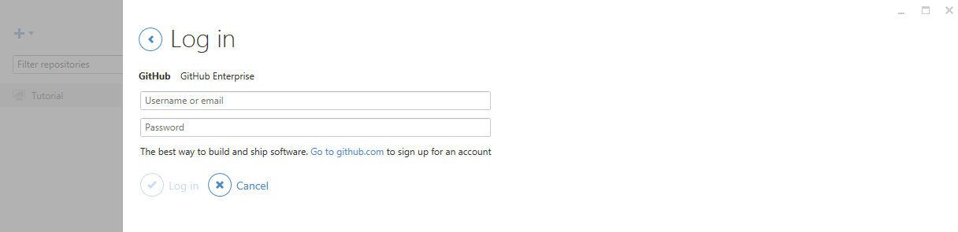
Git
For Windows user, please open GitHub desktop by double clicking icon
login to your GitHub desktop with your GitHub account (It is very important to login before you do the rest of steps. Because after you login, you secure connection has been made)

Slide 7

Git
Then open Git Shell by clicking icon

Slide 8
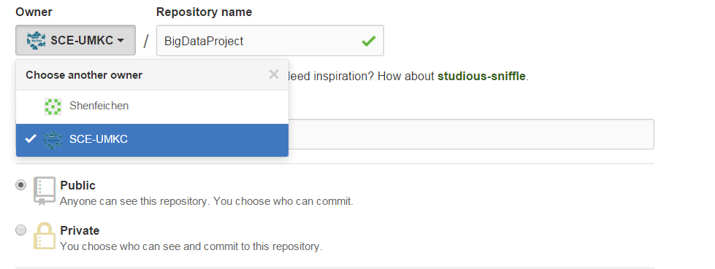
Git 1. Create Repository
We will add each group to our created organization “SCE-UMKC”.
Create your project under Owner SCE-UMKC, give a project name. That is the repository. E.g., Project Naming RealTime-Fall2016-YourProjectName
If you are not the member of SCE-UMKC yet, you can just create a repository under your username

Slide 9
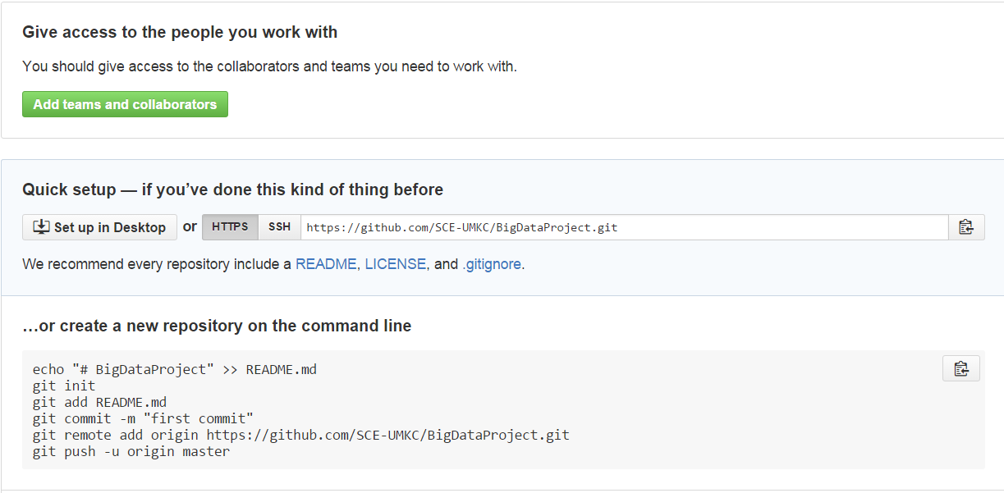
Git 2. Clone repository to your local
git clone https://github.com/xxxxxxx.git

Slide 10
Git
After clone, you will find a folder has the same name as repository
Use the following command to go inside the folder
cd <folder_name> (e.g., cd BigDataProject)

Slide 11
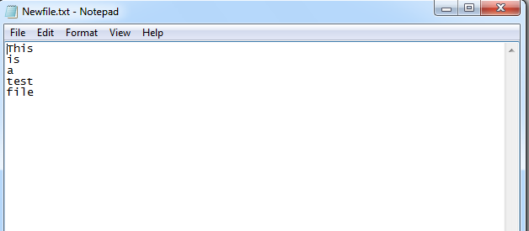
Git 3. Add file to local repository
In the local repository folder, we can add a new file
If you are a Linux or a Mac user
vi Newfile.txt
If you are a Windows user
echo This is a test file > Newfile.txt

Slide 12
Git 4. Commit this change
git commit –m ‘Someone committed on Sometime’
After commit, you can check git status to see if work directory clean
git status

Slide 13
Git 5. Push the change to remote
For Windows user, we first test if we are able to connect to GitHub
ssh -T git@github.com
https://help.github.com/articles/generating-ssh-keys

Slide 14
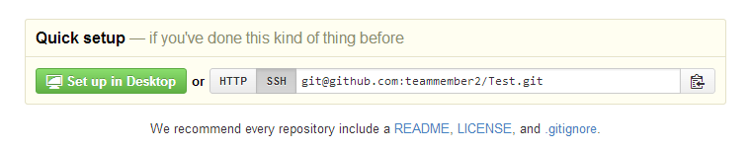
Git 5. Push the change to remote
Setup remote connection by SSH git address git remote set-url origin git@gxxxxxx.git

Slide 15
Git 5. Push the change to remote
Now you can push all to GitHub
git push --all

Slide 16
Git 6. Sync local with remote
If something change in remote, for sync purpose, you can type
git pull

Slide 17
For now, Windows users have done all basic steps.
But for Linux and Mac users, there are some more steps

Slide 18
Git 5. Push the change to remote (Non-Windows User)
For Linux or Mac user, we have more work to do before pushing change to remote
We have to setup SSH
Here are several steps

Slide 19
Git 5. Push the change to remote (Non-Windows User)
Generate a SSH key with your github email address
ssh-keygen -t rsa –C ‘your_email@example.com‘
It will ask you the file name to save this key and passphrase. Give the key name and make passphrase as empty.
For example, we give key name as id_rsa, key pair would be:
id_rsa and id_rsa.pub

Slide 20
Git 5. Push the change to remote (Non-Windows User)
(2) Add your new private key to the ssh-agent
ssh-agent -s
eval $(ssh-agent)
ssh-add Your_Key_Name

Slide 21
Git 5. Push the change to remote (Non-Windows User)
(3) Copy public key to your github account
vi Your_Key_Name.pub
Copy the content of this file

Slide 22
Git 5. Push the change to remote (Non-Windows User)
(4) Copy key to your GitHub account
In the user bar in the top-right corner of any page, click setting button
Click SSH Keys in the left sidebar.
Click Add SSH key.
In the Title field, add a descriptive label for key
Paste your key into the "Key" field.
Click Add key.

Slide 23
Git 5. Push the change to remote (Non-Windows User)
(5) SSH to github for testing ssh -T git@github.com

Slide 24
Git 5. Push the change to remote (Non-Windows User)
(6) Switching remote URLs from HTTPs to SSH git remote set-url origin git@gxxxxxx.git

Slide 25
Git 5. Push the change to remote (Non-Windows User)
(7) Now you can push
git push --all

Slide 26
Git 6. Sync local with remote (Non-Windows User)
If something change in remote, for sync purpose, you can type
git pull

Slide 27
Git Project Management 1. Branch
A and B work on the same project
A wants to develop on feature A
B wants to develop on feature B
They work in parallel
BranchA and BranchB

Slide 28
Git Project Management 1. Branch
Create a branch
git branch branchA
Delete a branch
git branch –d branchA
Force delete a branch
git branch –D branchA
Rename the current branch
git branch –m branchA

Slide 29
Git Project Management 2. Checkout
A and B has to checkout their own branch to work on
git checkout branchA
git checkout branchB

Slide 30
Git Project Management 3. Merge
User A works on featureA, after finish, user A commit it with the message ‘finish featureA’
git commit –m ‘finish featureA’
User B works on featureB, after finish, user B commit it with the message ‘finish featureB’
git commit –m ‘finish featureB’
User C works on main features on master branch, user C commit it with the message ‘finish main features’
git commit –m ‘finish main features’

Slide 31
Git Project Management 3. Merge
In master, we can merge all features and delete branchA and branchB
git checkout master
git merge branchA
git merge branchB
git branch –d branchA
git branch –d branchB

Slide 32
Git Project Management 3. Merge
At last, master push all change to remote repository
git push --all

Slide 33
Code Contribution
The Code Contribution on the Github Project will be used to evaluate your individual score on the contribution towards the project.

Slide 34
INTELLIJ

Slide 35
IntelliJ
Java- Scala integrated development environment (IDE)
Can be Downloaded from https://www.jetbrains.com/idea/

Slide 36
Intellij Ubuntu
https://www.jetbrains.com/idea/download/#section=linux
Move to desired installation location
Unpack the idea idea-2016.3.3.tar.gz file using the following command: tar xfz idea-2016.3.3.tar.gz
Run idea.sh from the bin subdirectory
To run idea.sh: command: sh idea.sh

Slide 37
Attention
Make sure to add Scala to IntelliJ environment while installing

Slide 38
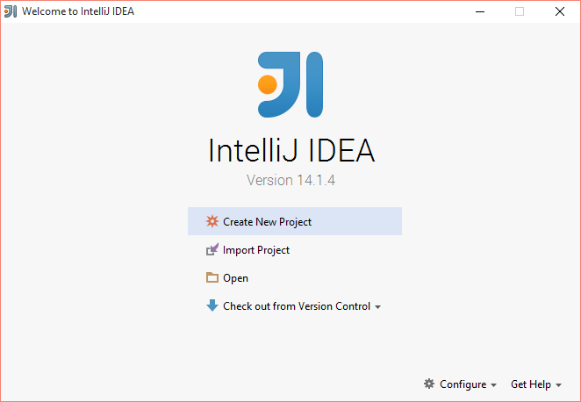

Slide 39
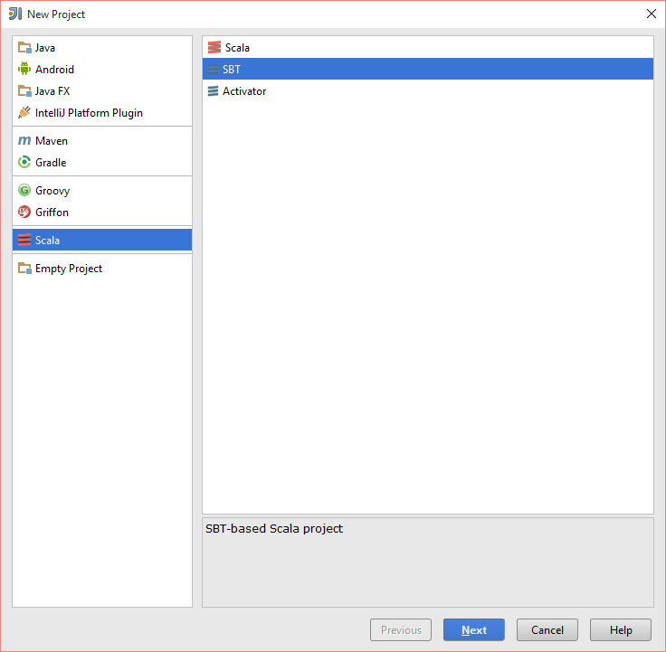
For Scala Project

Slide 40
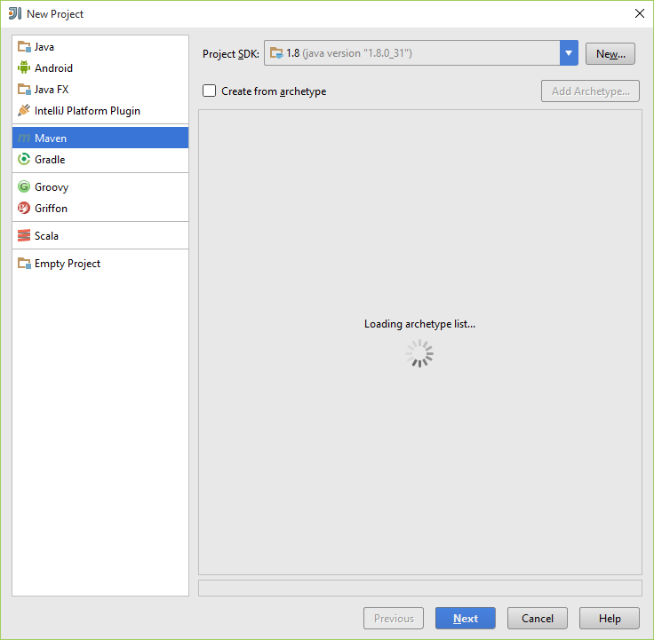
For Java Project

Slide 41
Using Git in IntelliJ
https://www.jetbrains.com/help/idea/2017.1/using-git-integration.html

Slide 42
BUILD TOOLS: SBT and MAVEN

Slide 43
What is Build Tools?
Build automation is the act of scripting or automating a wide variety of tasks that software developers do in their day-to-day activities including things like:
compiling computer source code into binary code
packaging binary code
running automated tests
deploying to production systems
creating documentation and/or release notes

Slide 44
SBT
SBT stands for Scala Build Tool
SBT is an open source build tool for Scala and Java projects, similar to Java's Maven or Ant.

Slide 45
SBT - Installation
http://www.scala-sbt.org/0.13/tutorial/Installing-sbt-on-Windows.html
Install SBT.

Slide 46
SBT Commands
sbt clean : cleans the jars and classes generated from previous run
sbt package : creates a light jar, with the classes generated
sbt assembly : creates a fat jar without all the dependies compiled with it.
Note : we would be creating fat jar for deployment in spark

Slide 47
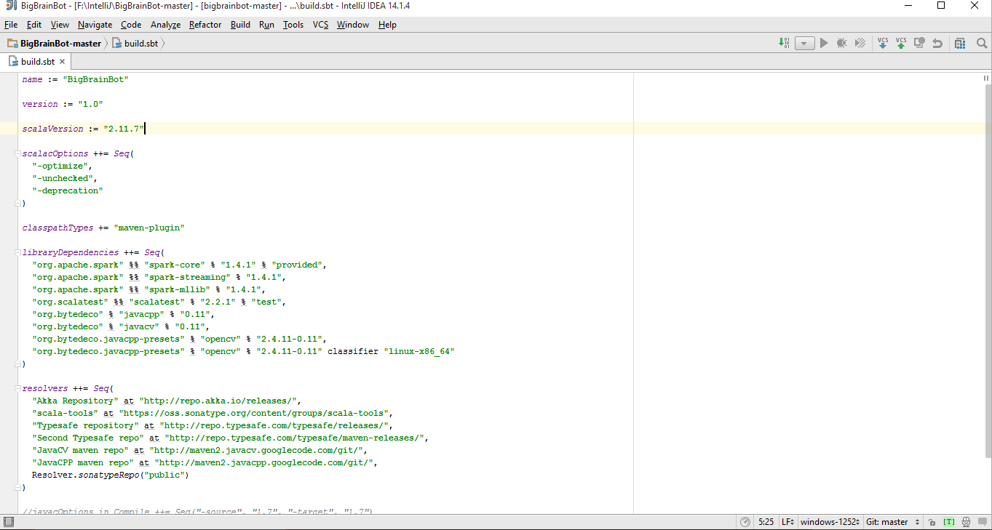
SBT related Files
Two main files which are involved with sbt are
Build.sbt : Dependencies libraries are specified

Slide 48
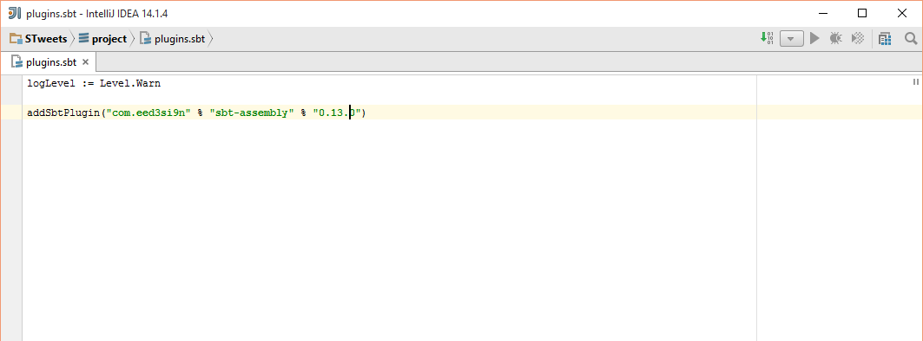
SBT related Files
Plugins.sbt / assembly.sbt : The version of sbt used is specified in this

Slide 49
Maven
Apache Maven is a software project management and comprehension tool. Based on the concept of a project object model (POM), Maven can manage a project's build, reporting and documentation from a central piece of information.

Slide 50
Maven - Installation
https://maven.apache.org/
Install Maven

Slide 51
Maven Commands
mvn compile - compile the source code of the project
mvn test - test the compiled source code using a suitable unit testing framework. These tests should not require the code be packaged or deployed
mvn package - take the compiled code and package it in its distributable format, such as a JAR.

Slide 52
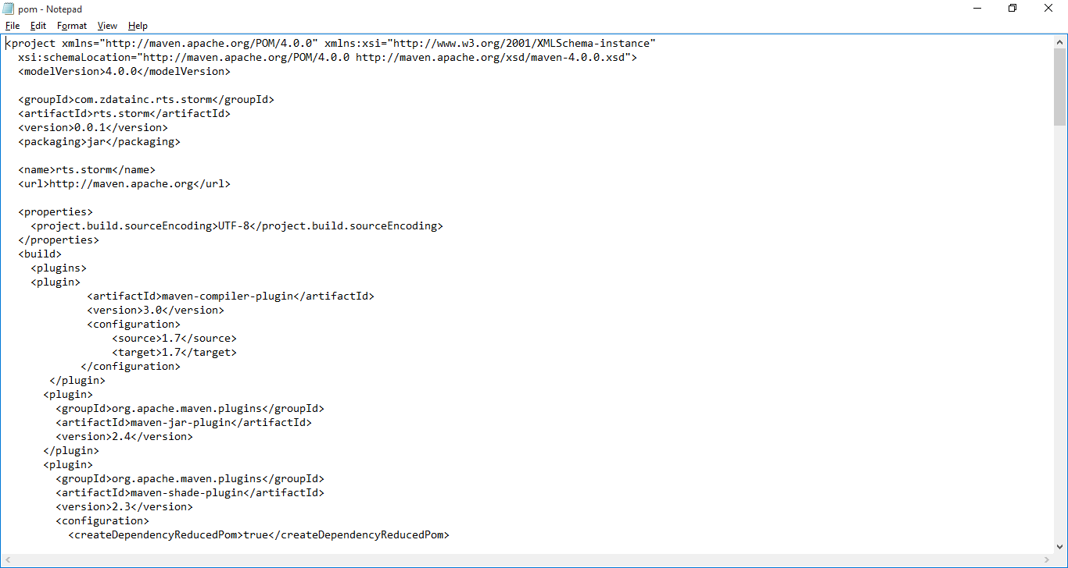
Maven related File: pom.xml

Slide 53
Wiki: Lab Submission
Create a repository for all Lab assignment submissions
Create a folder for each lab assignment and place all code inside source code folder
Use Github wiki pages to submit reports for each lab
Include all wiki links in README.md file

Slide 54
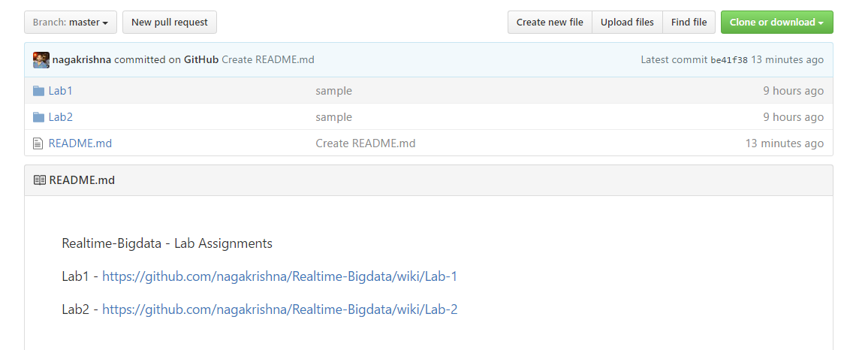
Wiki: Lab Submission

Slide 55
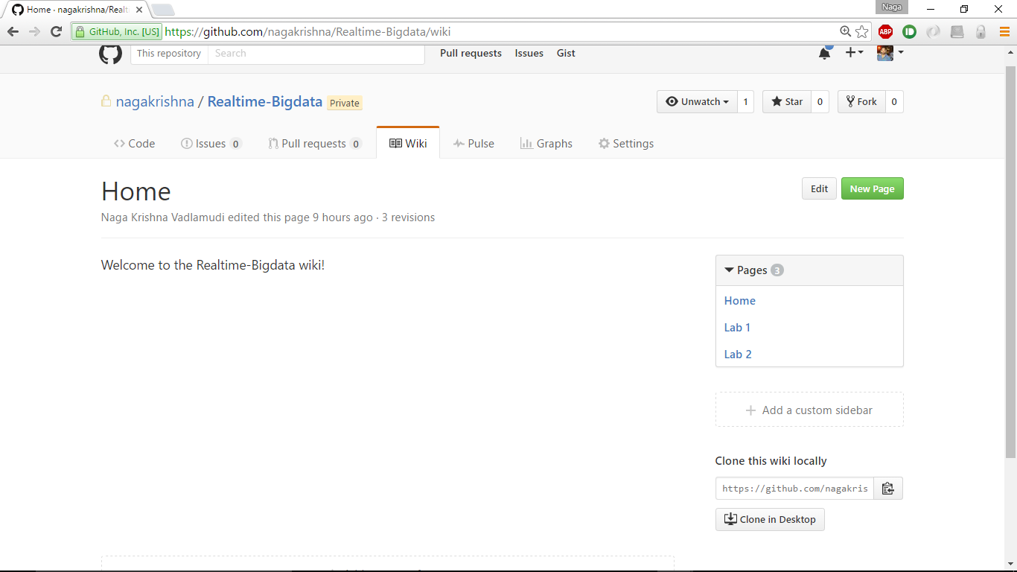
Wiki: Lab Submission

Slide 56
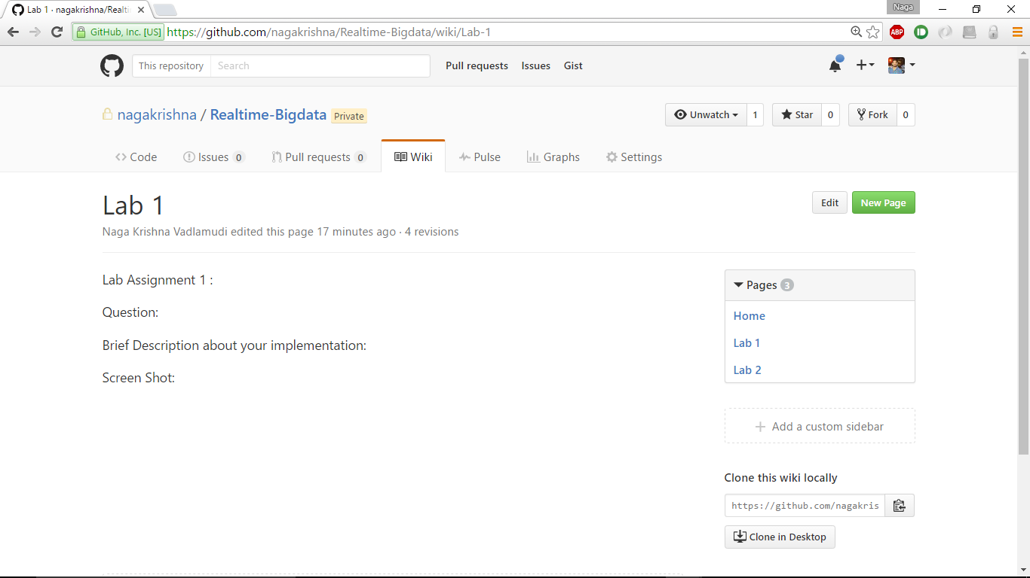
Wiki: Lab Submission

Slide 57
END

